Slide 1
Great Neck Park District Database
Alexis Tubiolo
Brian Sprague
Hiu Cheng
Huei Peng Chen
Marcanthony Liggieri

Slide 2
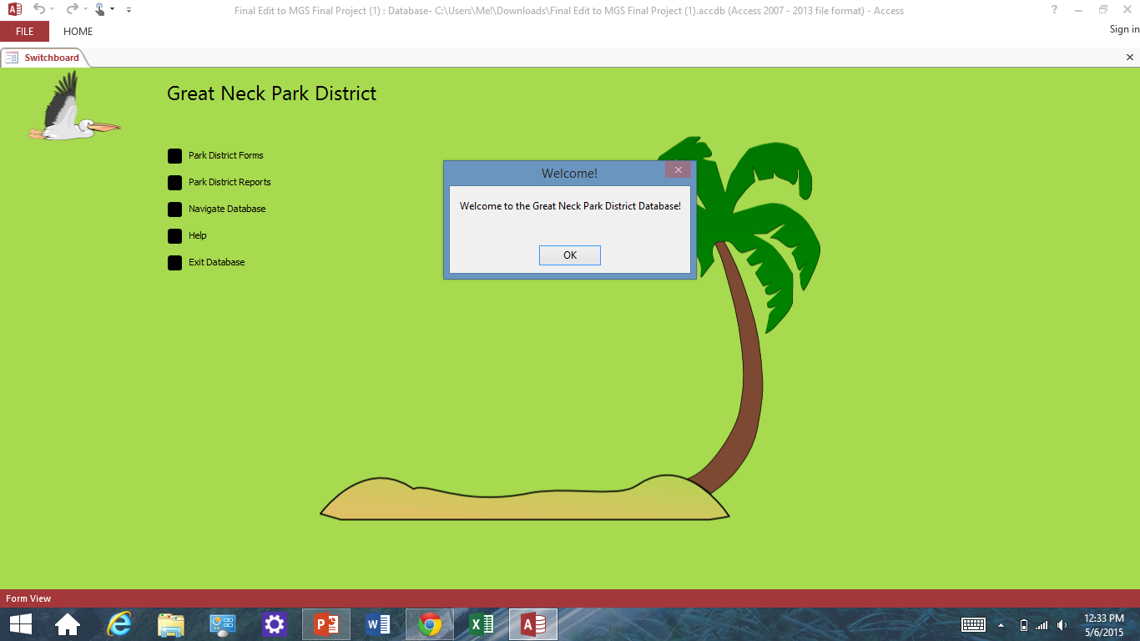
Main menu

Slide 3
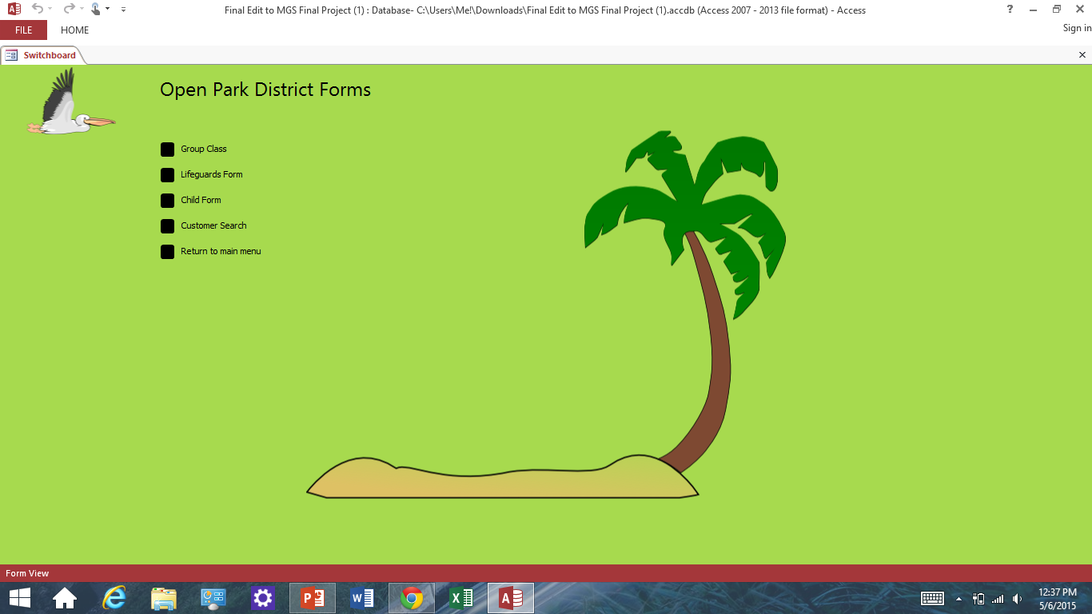
Forms Menu

Slide 4
Reports menu

Slide 5
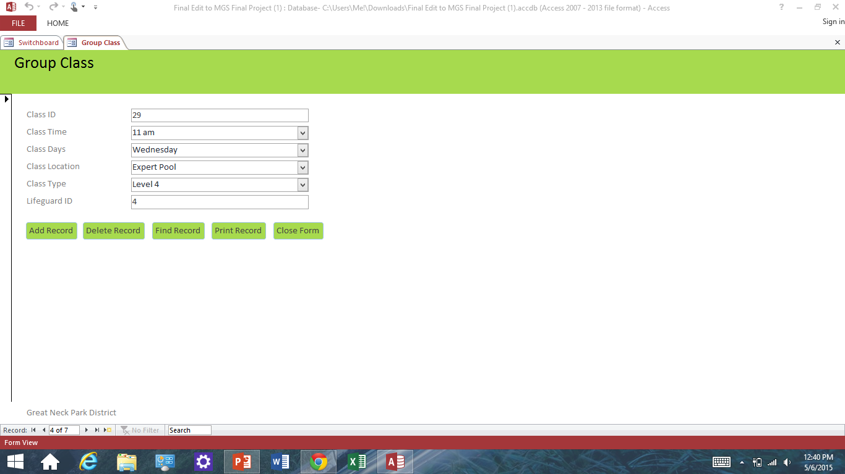
Group Class Form

Slide 6
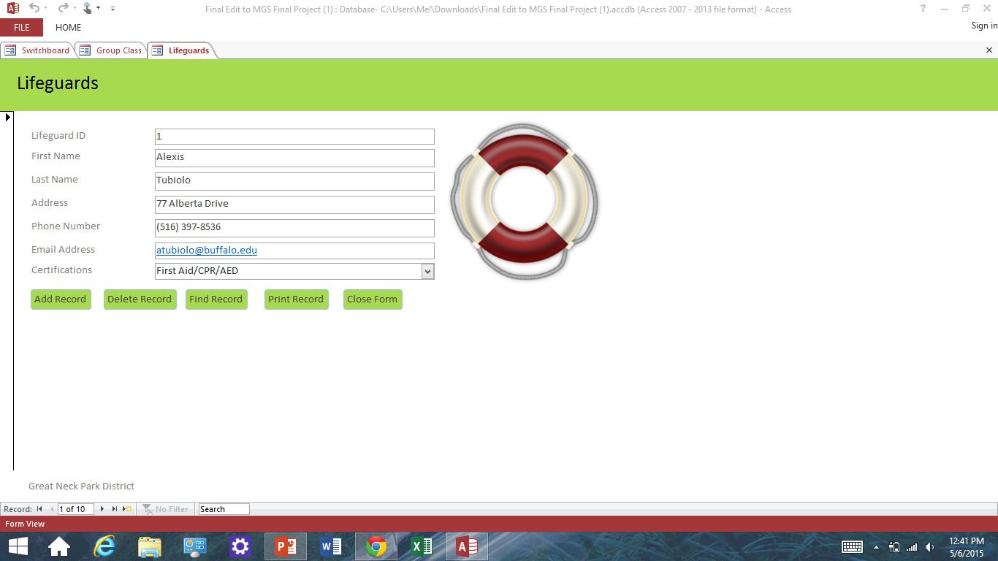
Lifeguard Form

Slide 7
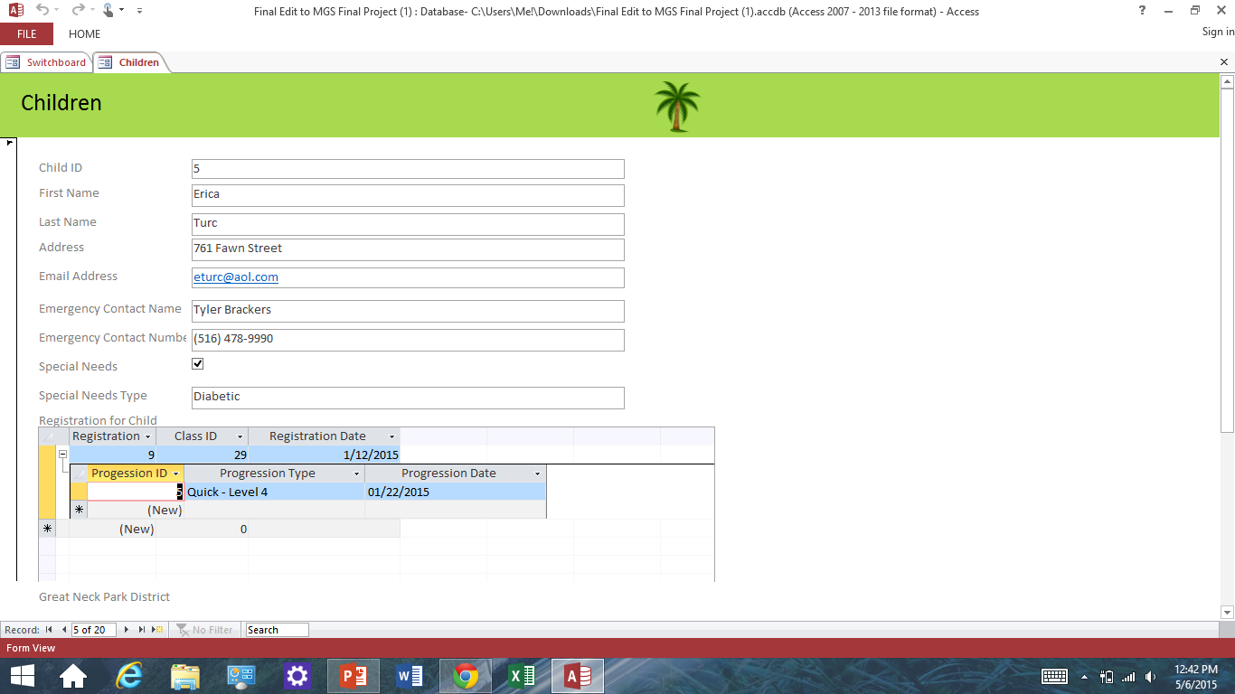
Children form

Slide 8
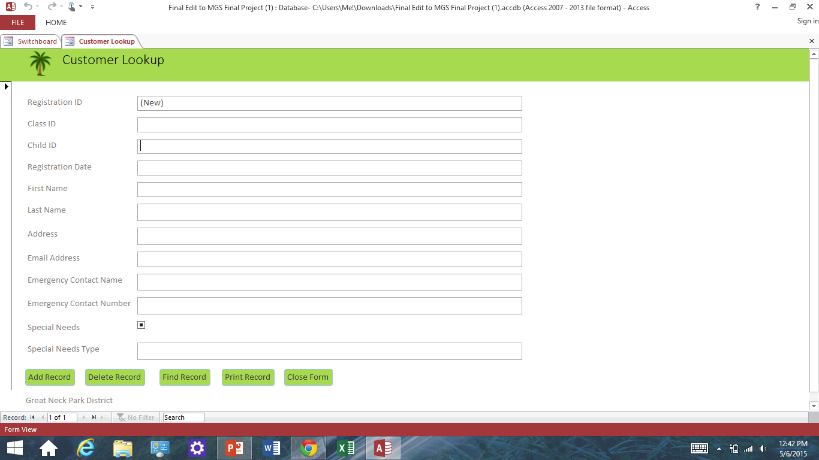
Customer Lookup

Slide 9
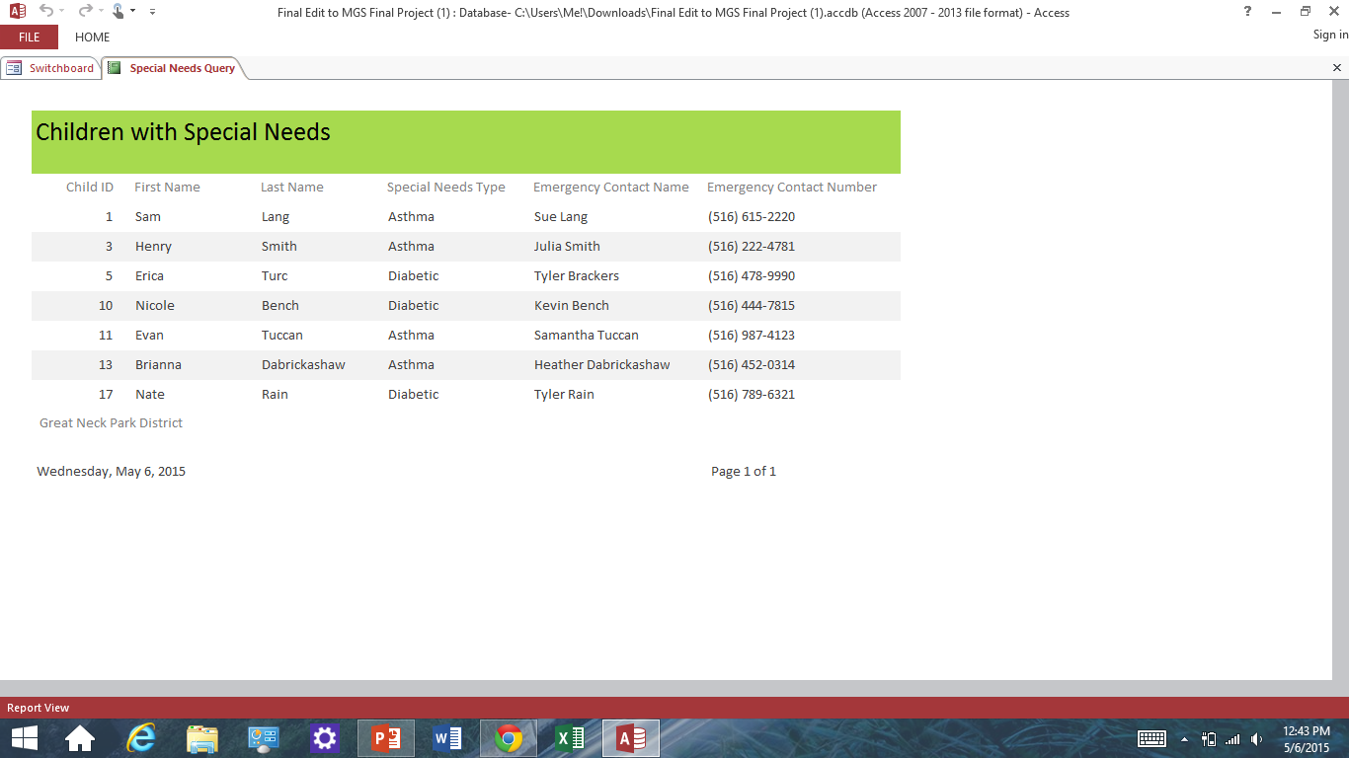
Special Needs report

Slide 10
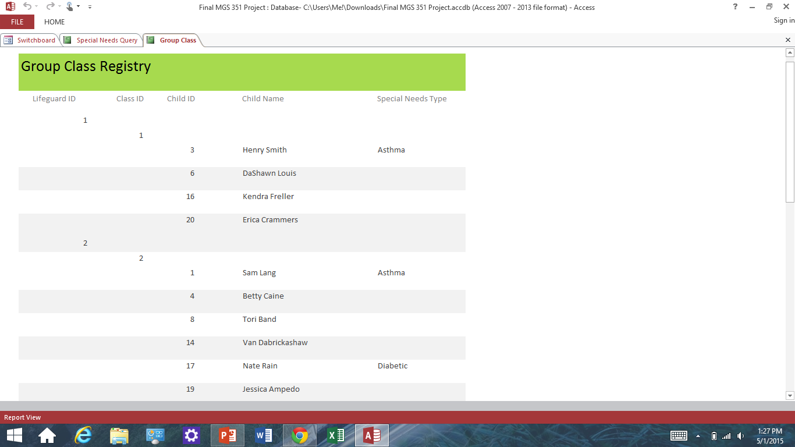
Group Class report

Slide 11
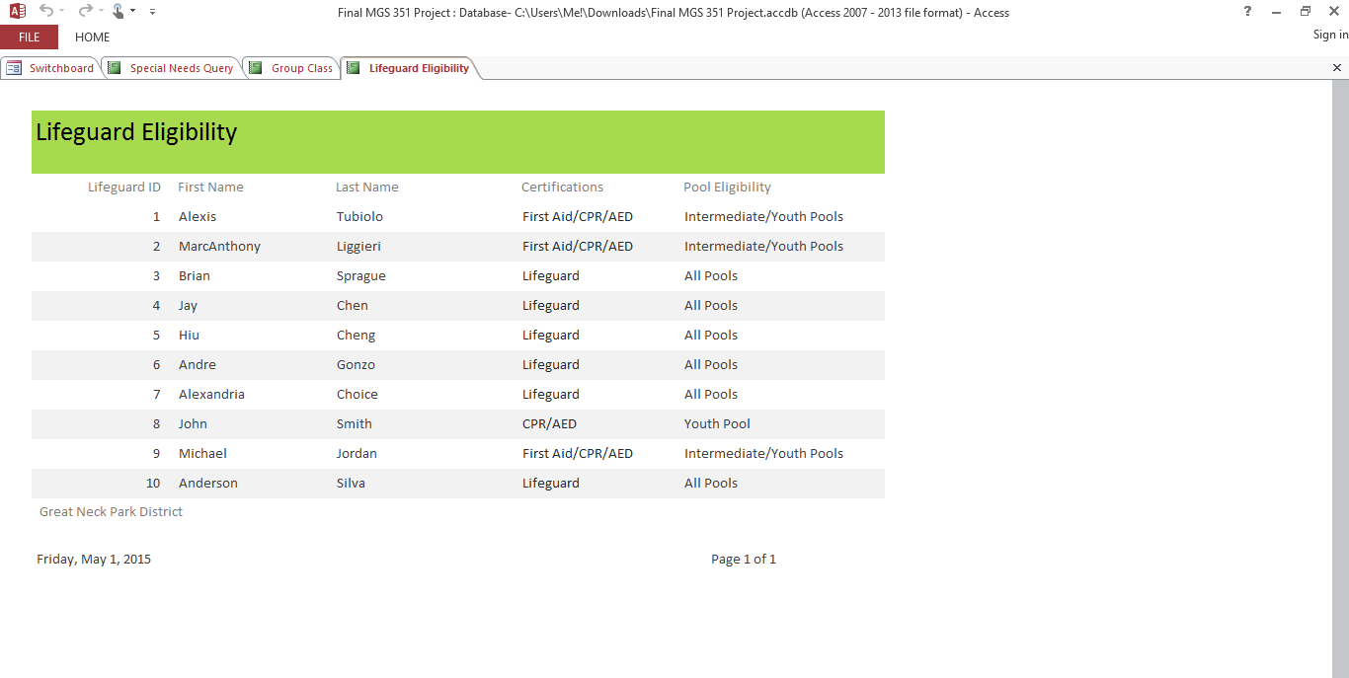
Lifeguard Eligibility

Slide 12
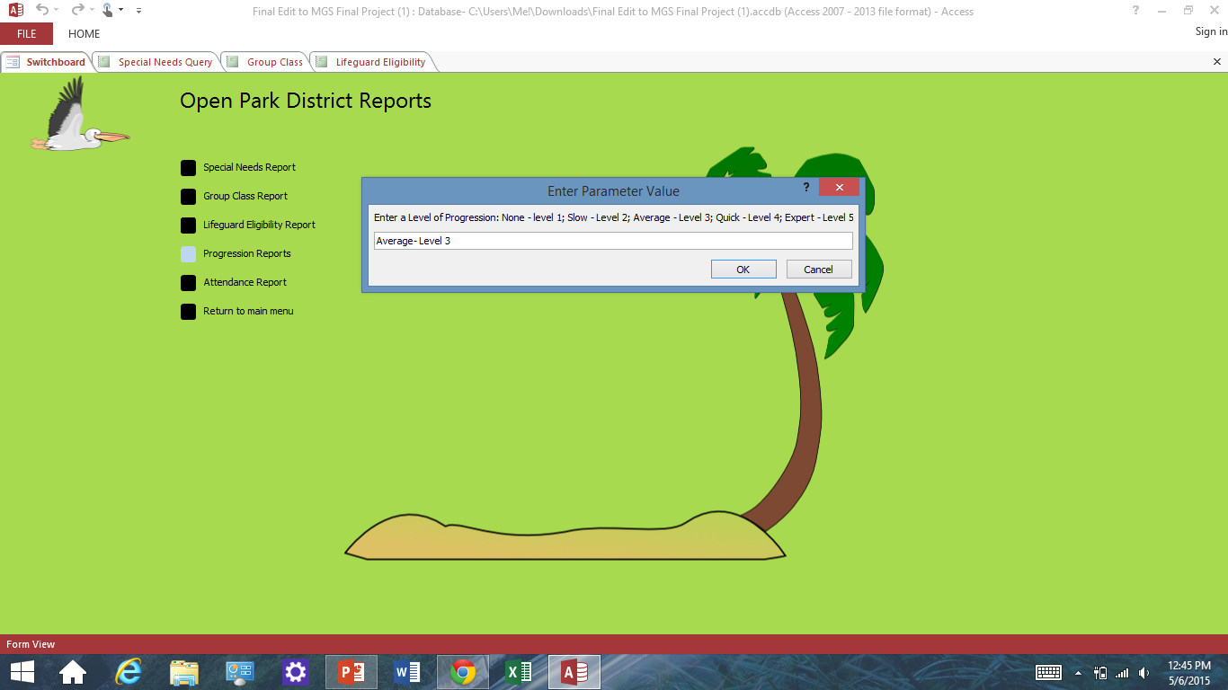
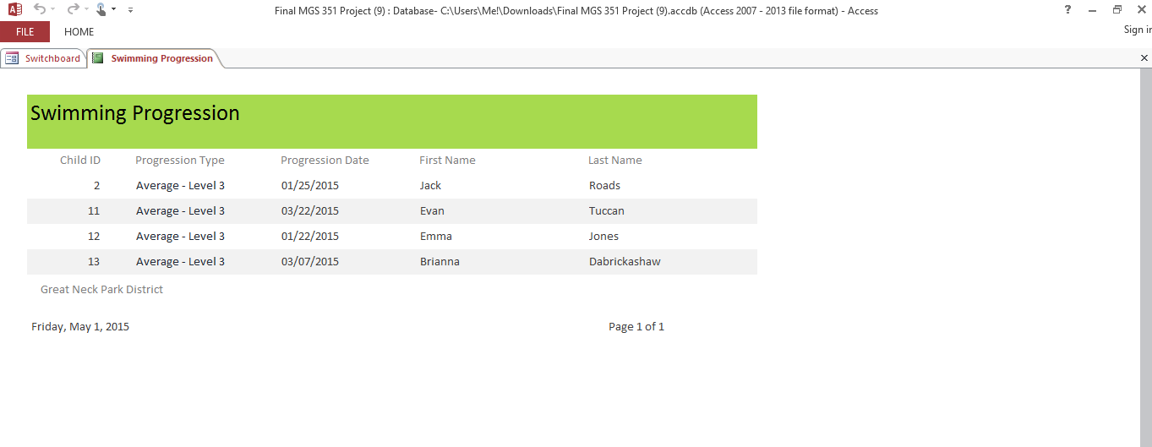
Progression Report

Slide 13
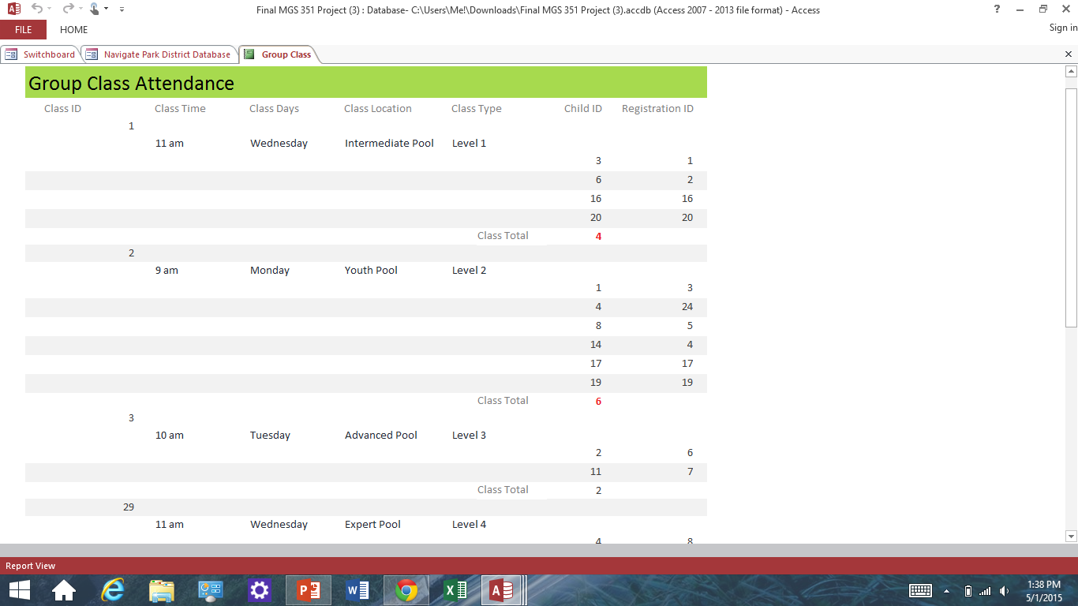
Attendance report

Slide 14
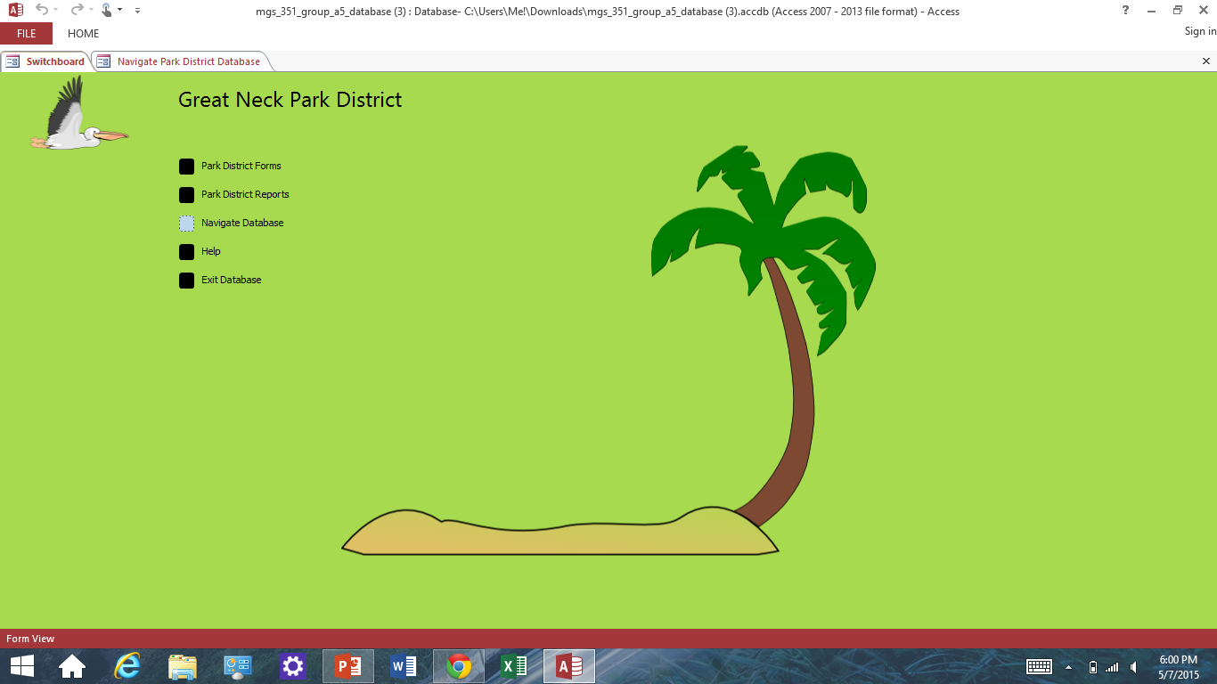
Navigate Database

Slide 15
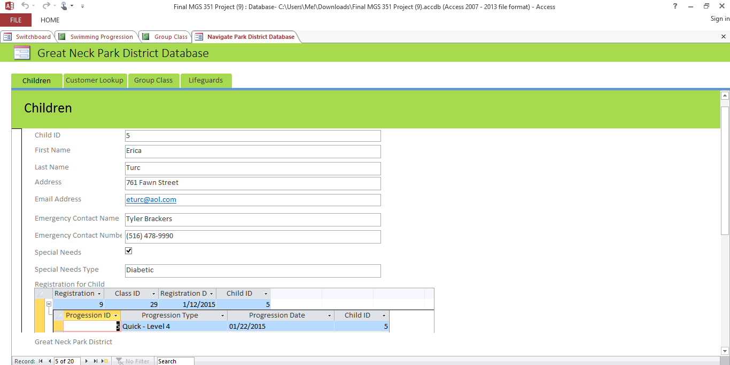
Navigation Children

Slide 16
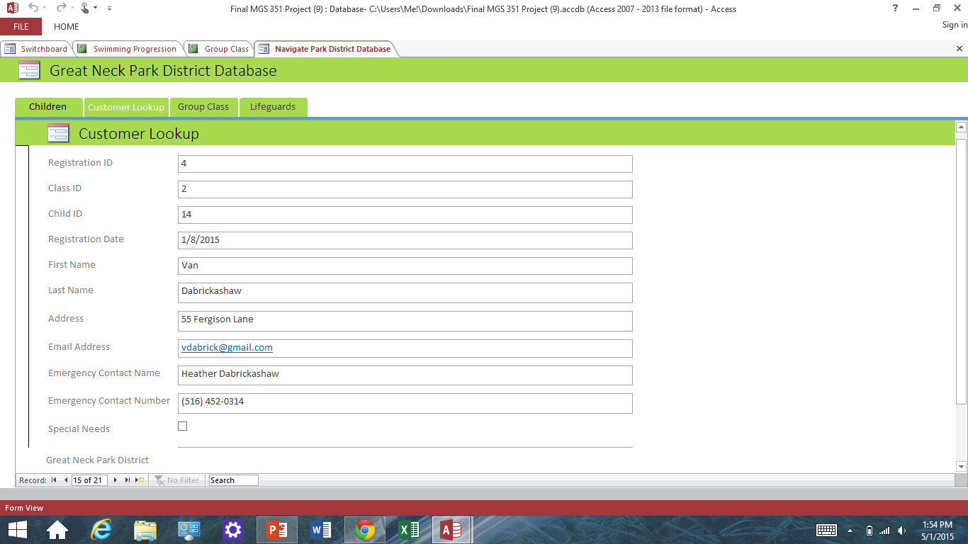
Navigation Customer Lookup

Slide 17
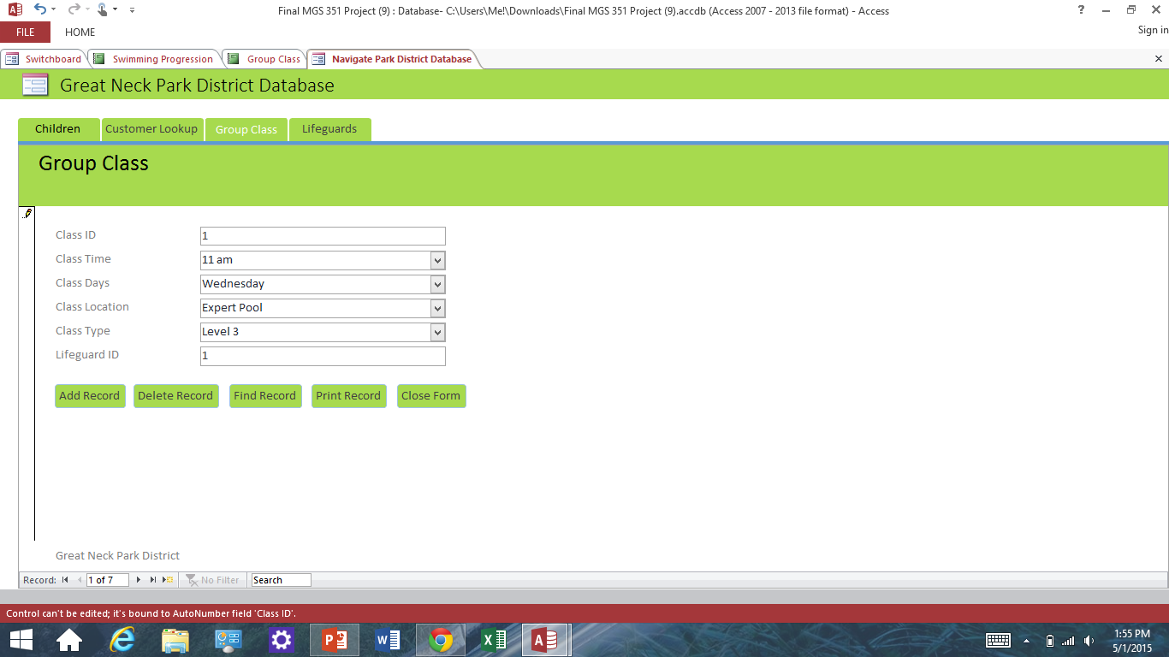
Navigation Group Class

Slide 18
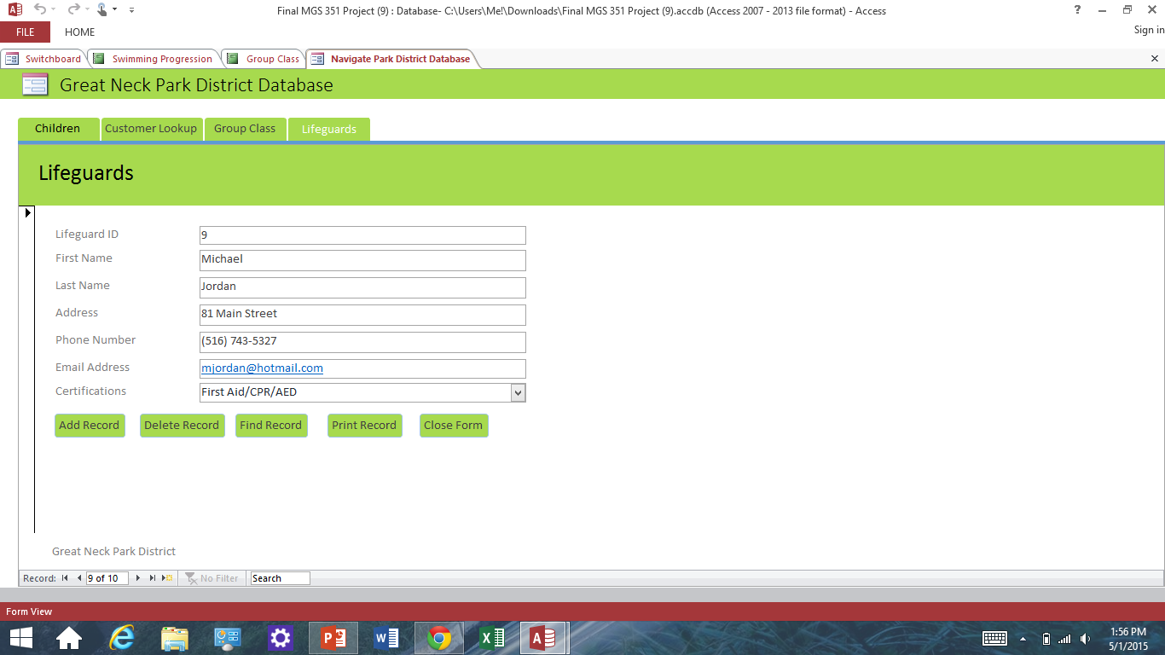
Navigation Lifeguard

Slide 19
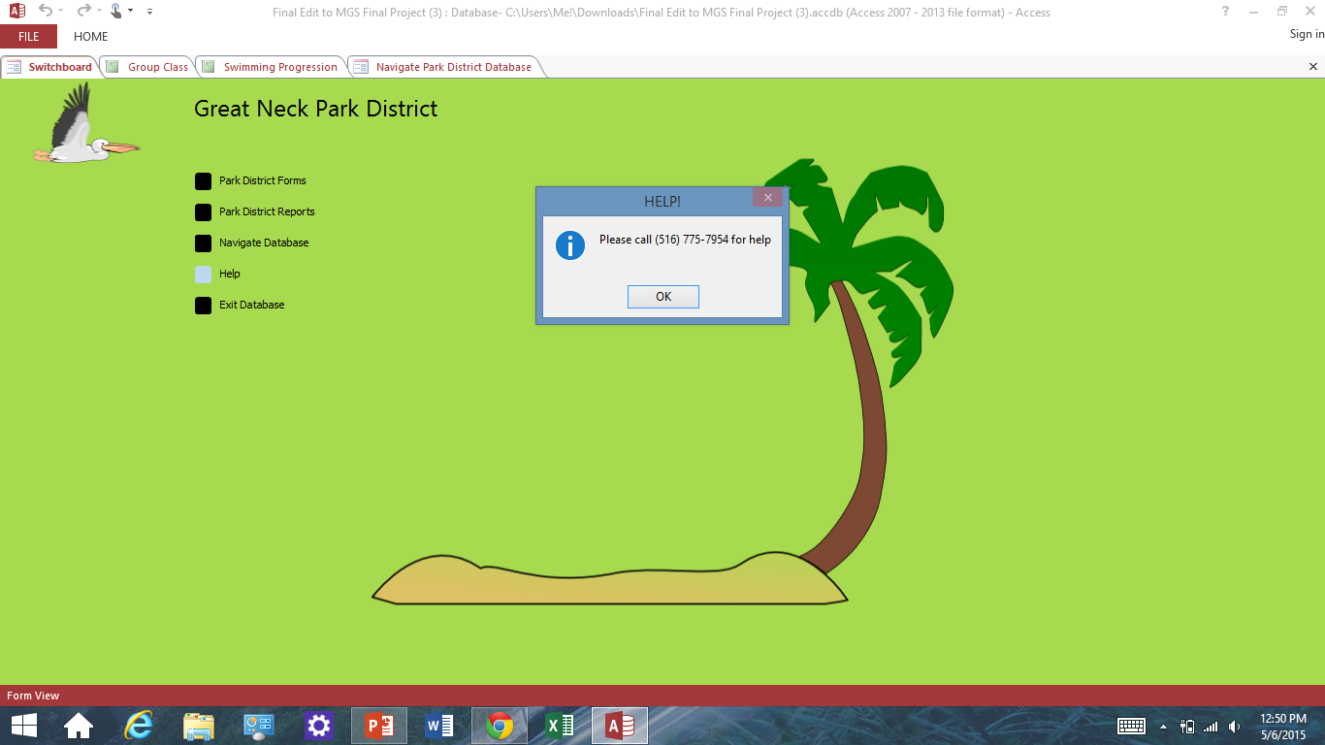
Help for Assistance

Slide 21
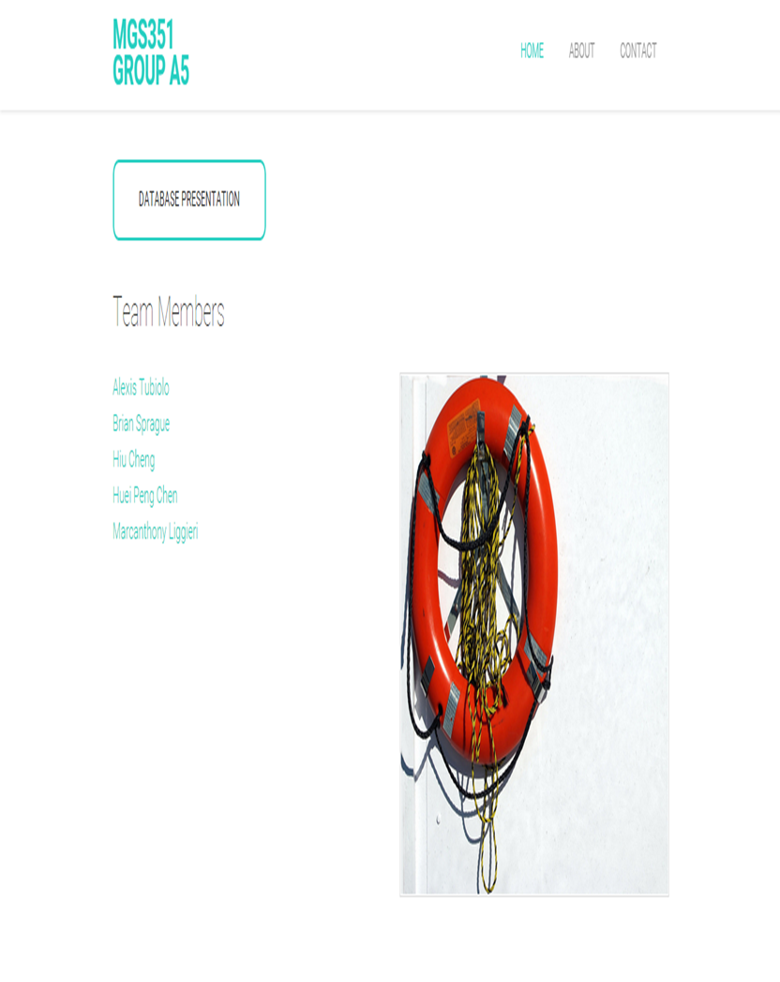

Slide 22
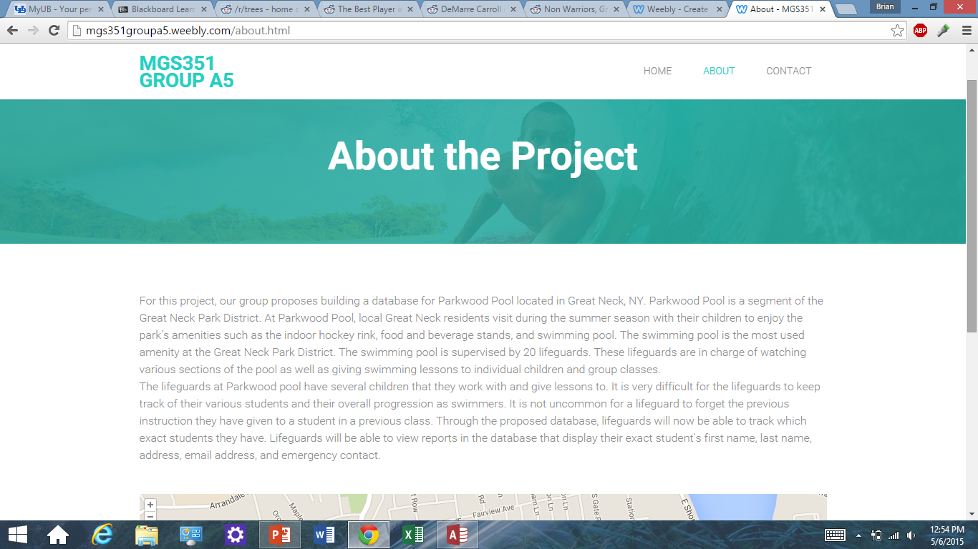

Slide 23
